Slide 1
Non-Comparison Sorting
Chapter 7

Slide 2
Comparison vs. Non-Comparison Sorting
Comparison sorting can be used with any comparable data regardless of the range or distribution of values
Time complexity of sorting algorithms using only comparisons has a lower bound of 𝜴(n*log(n))
Using non-comparison sorting algorithms it is possible to reach θ(n) time complexity for data within a limited range with a particular distribution

Slide 3
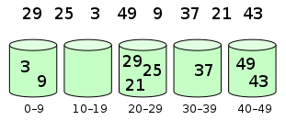
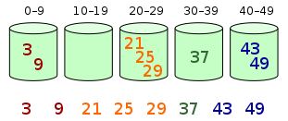
Sorting – Bucket Sort
1. Set up an array of initially empty "buckets".
2. Scatter: Go over the original array, putting
each object in its bucket.
3. Sort each non-empty bucket.
4. Gather: Visit the buckets in order and put
all elements back into the original array.
https://en.wikipedia.org/wiki/File:Bucket_sort_1.svg
https://en.wikipedia.org/wiki/File:Bucket_sort_2.svg
Notes:
Distribute the elements of an array into a number of buckets. Each bucket is then sorted individually, either using a different sorting algorithm, or by recursively applying the bucket sorting algorithm.
TIME
BEST = O(n) 1 item per bucket (n buckets covering range of data with evenly distributed data)
WORST = O(n²) All items in single bucket sorted with O(n²) algorithm
AVG = O(n + (n²/k) + k) using k buckets covering distribution of data, O(n) when n is proportional to k
SPACE – O(n*k) k buckets may hold up to n items, O(n) if using dynamically allocated arrays/vectors
STABLE? – yes, if sorting algorithm for each individual bucket is stable

Slide 4
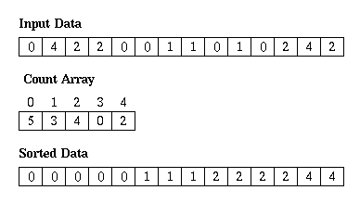
Sorting – Counting Sort
https://www.cs.rit.edu/~vcss233/Labs/lab05/images/count_sort_exp.gif
Notes:
Useful with a list containing a narrow range of key values occurring multiple times. Operates by counting the number of objects that have each distinct key value, and using arithmetic on those counts to determine the positions of each key value in the output sequence. Its running time is linear in the number of items and the difference between the maximum and minimum key values, so it is only suitable for direct use in situations where the variation in keys is not significantly greater than the number of items. However, it is often used as a subroutine in another sorting algorithm, radix sort, that can handle larger keys more efficiently.
TIME
BEST / WORST / AVG = O(n+k) n items, k key values
SPACE – O(n+k) count #times each of k keys appears, place n items into sorted data array in order
STABLE? – yes

Slide 5
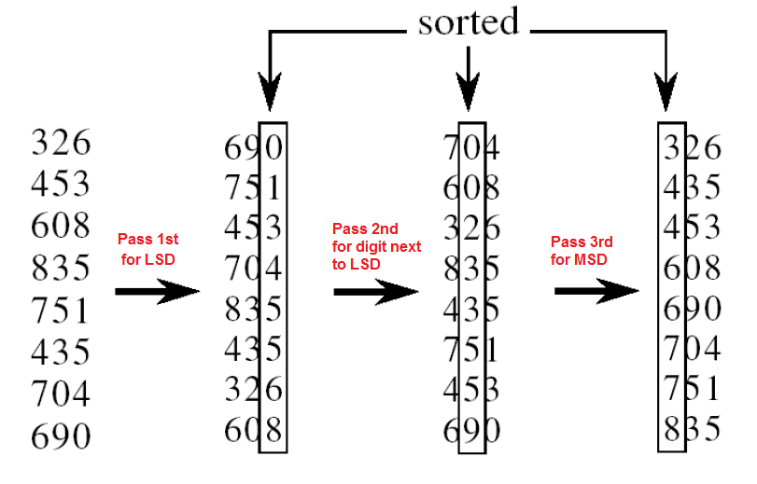
Sorting – Radix Sort
https://www.codingeek.com/wp-content/uploads/2017/02/radix.png
Notes:
Radix sort is a non-comparative sorting algorithm. It avoids comparison by creating and distributing elements into buckets according to their radix. For elements with more than one significant digit, this bucketing process is repeated for each digit, while preserving the ordering of the prior step, until all digits have been considered. Can Either start with least significant digit (LSD, shown in figure) or most significant digit (MSD).
TIME
BEST / WORST / AVG = O(n*k) n items, k digits in key
SPACE – O(n+k): n: number of items, k: number of value for digit (base)
STABLE? – depends, LSD first is stable, in-place approaches and MSD first generally not stable

